Slide 1
ESQL Python Compiler
Team Beast Mode
William Arachelian & Marcus Hom

Slide 2
Project Overview
Goal: Produce a python compiler for ESQL queries that simplify cost and complexity of ad hoc OLAP queries in standard SQL.
Complex SQL expressions lead to complex relational algebra expressions, with multiple joins, group-bys, and subqueries, making it both difficult and inefficient to calculate desired aggregate results.
ESQL makes calculations simpler by using an iterative approach and introduces grouping variables and the SUCH THAT clause that reduces complexity of queries.

Slide 3
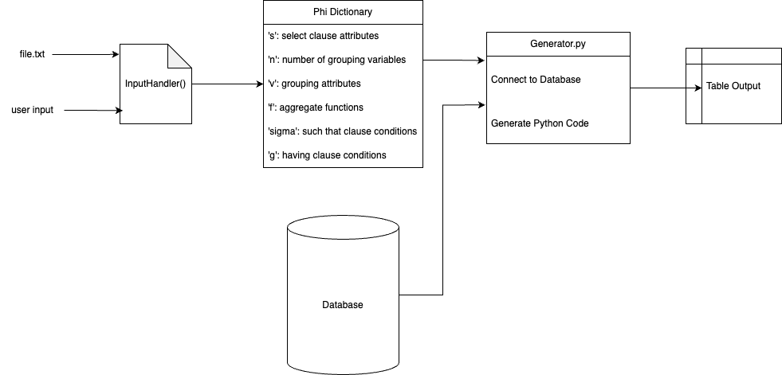
Project Architecture
Algorithm Generation:
-Parse each .txt file. Headers indicate what part of the phi dictionary we are looking at. Creates MF structure based on inputs (list that gets output).Each mf structure entry is a dictionary with keys of the grouping attributes and aggregate functions. Iteratively go through database and update output list based on database criteria (state=’NY’, quant>20). After fully updated, filter again based on having clause. Lastly, runs a cleanup function that removes any attributes that aren’t in select clause

Slide 4
Query Structure
List of parameters representing phi operator following the format:
SELECT ATTRIBUTES (S)
NUMBER OF GROUPING VARIABLES (n)
GROUPING ATTRIBUTES (V)
F-VECT ([F])
SELECT CONDITION-VECT ([σ])
HAVING_CONDITION (G)
Aggregate Attributes follow the form:
{Grouping Variable}_{Aggregate Function}_{Attribute}
Any string quantities must be in quotes ex: ‘NY’ or ‘NJ’
If there are no such that or having clauses, don’t include the header

Slide 5
Technologies
Database: PGAdmin 4
Python Libraries:
attrs v22.2.0
iniconfig v2.0.0
packaging v23.0
pluggy v1.0.0
psycopg2 v2.9.5
pytest v7.2.2
python-dotenv v1.0.0
tabulate v0.9.0

Slide 6
Limitations
No input validation, trust user to input consistent phi operator for ESQL query
Does not consider where clause seen in regular SQL
Possibly more, but we ran short on time

